Slide 1

Group 6
Analyzing the Audience

Slide 2
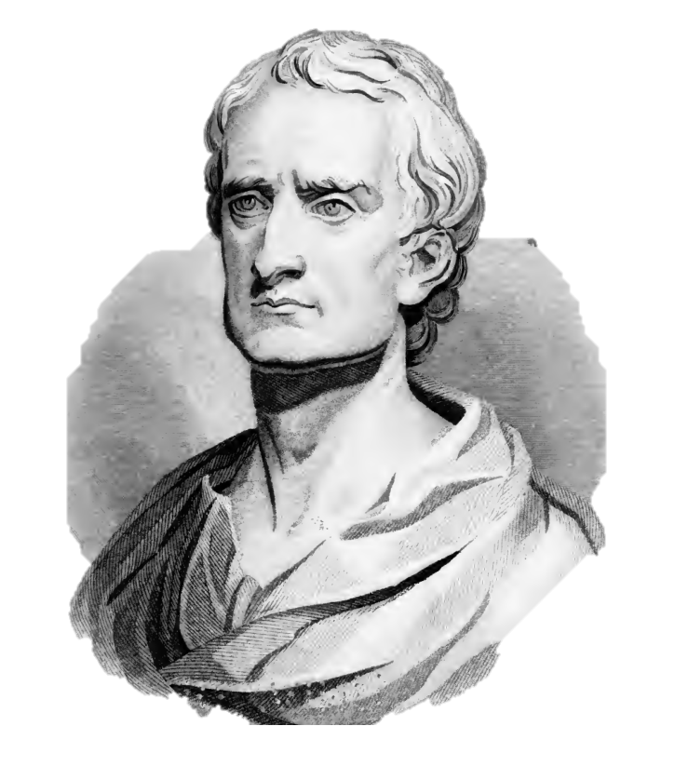
Sir Isaac Newton

Slide 3

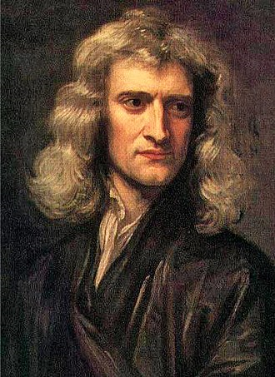
About Newton
Sir Isaac Newton PRS (25 December 1642 – 20 March 1726/27) was an English mathematician, physicist, astronomer, theologian, and author (described in his own day as a "natural philosopher") who is widely recognised as one of the most influential scientists of all time and as a key figure in the scientific revolution. His book Philosophiæ Naturalis Principia Mathematica (Mathematical Principles of Natural Philosophy), first published in 1687, laid the foundations of classical mechanics.
Notes:
英国皇家学会主席
一位英国数学家、物理学家、天文学家、神学家和作家，他被公认为有史以来最有影响力的科学家之一和科学革命的关键人物。 1687年，他首次出版了《自然哲学的数学原理》一书，奠定了自然哲学的数学原理经典力学的基础。

Slide 4
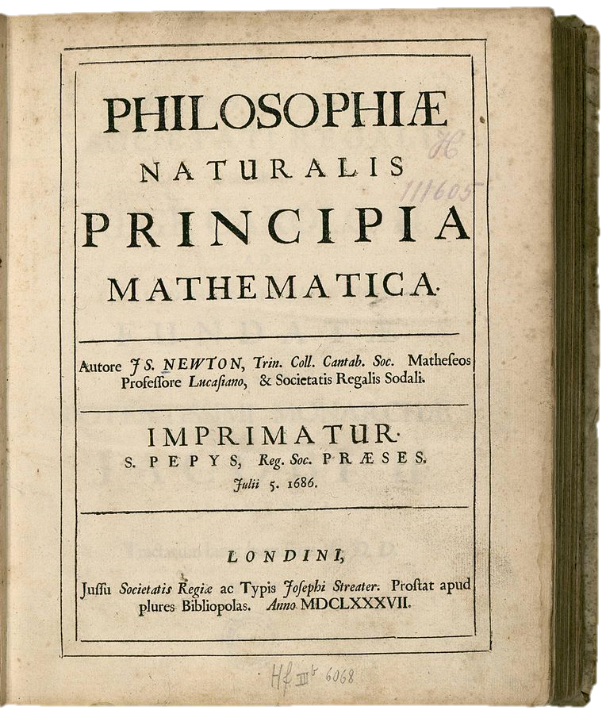
About Newton
Title page of Principia, first edition (1687)
Notes:
《自然哲学的数学原理》拉丁版封面(1687)

Slide 5
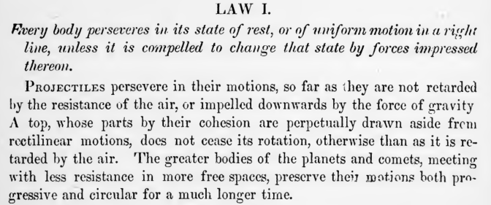
Newton first law
Notes:
书中的第一定律

Slide 6
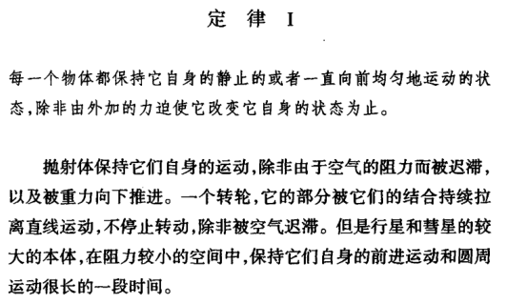
Newton first law
Notes:
中文版

Slide 7
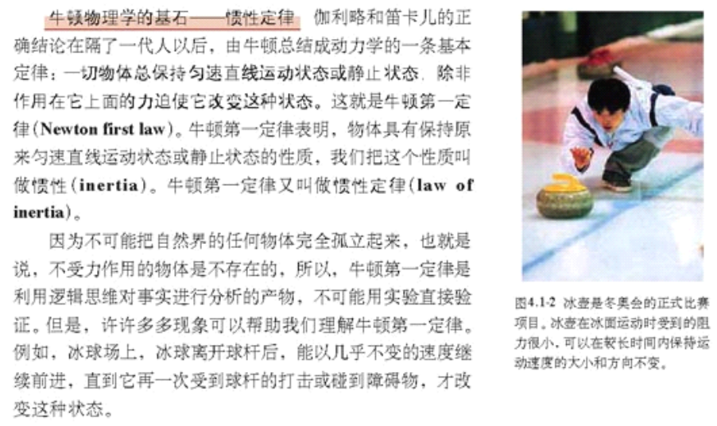
Newton first law
Notes:
高中物理必修一，又把牛顿第一定律叫做惯性定律，惯性与质量无关

Slide 8
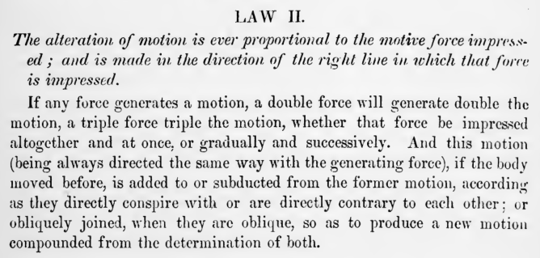
Newton second law

Slide 9
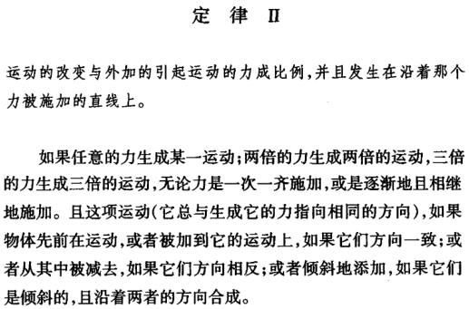
Newton second law

Slide 10
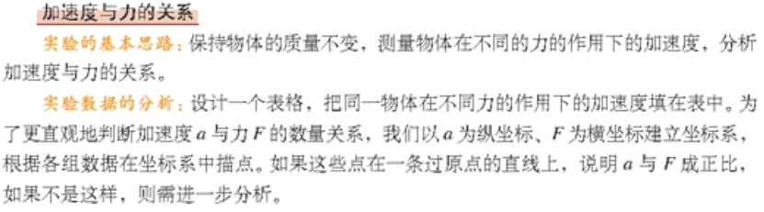
Newton second law
Notes:
必修一讲这里时先做了一个实验，就那个有打点计时器的小车实验，首先质量不变测加速度，发现a与F成正比

Slide 11
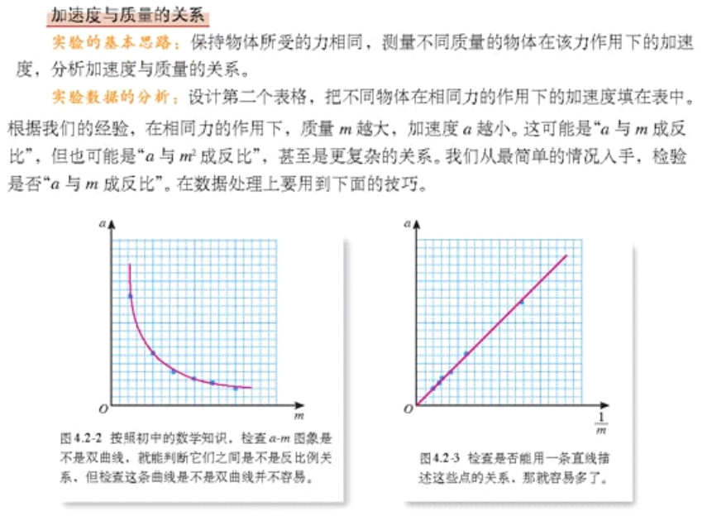
Newton second law
Notes:
然后力不变求加速度，发现a与m成反比

Slide 12
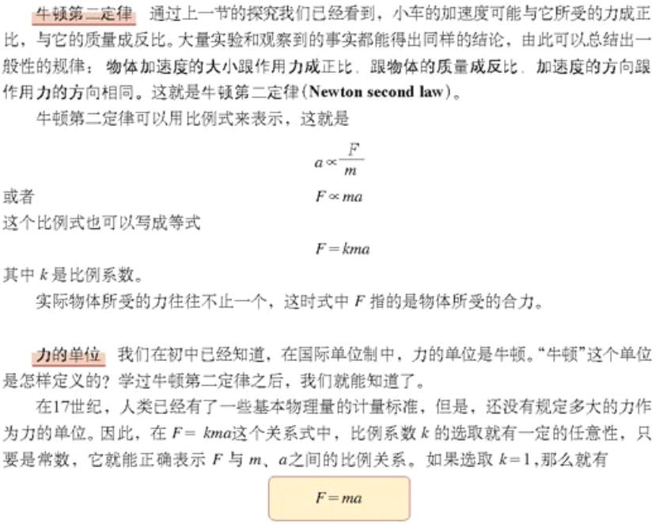
Newton second law
Notes:
最后得出结论F=kma

Slide 13
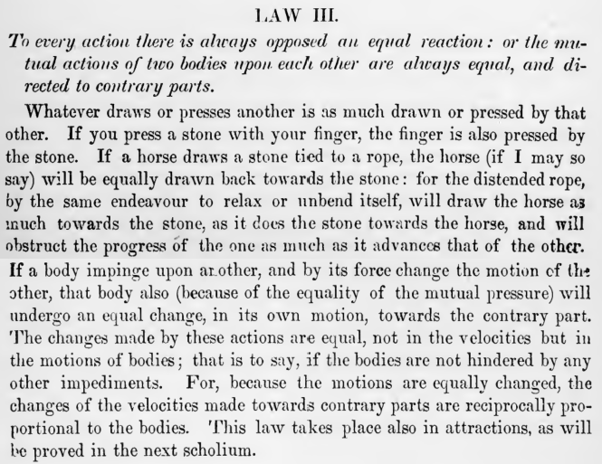
Newton third law

Slide 14
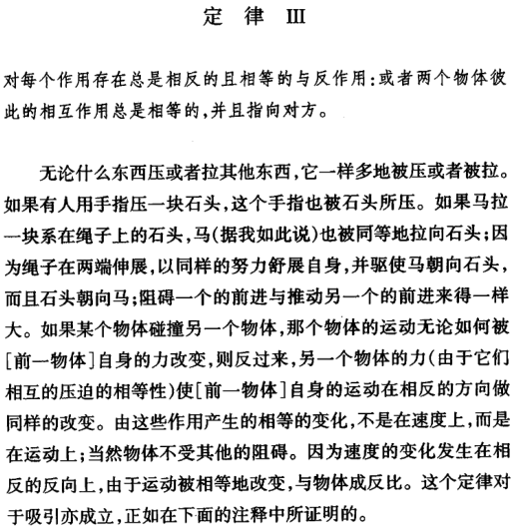
Newton third law

Slide 15
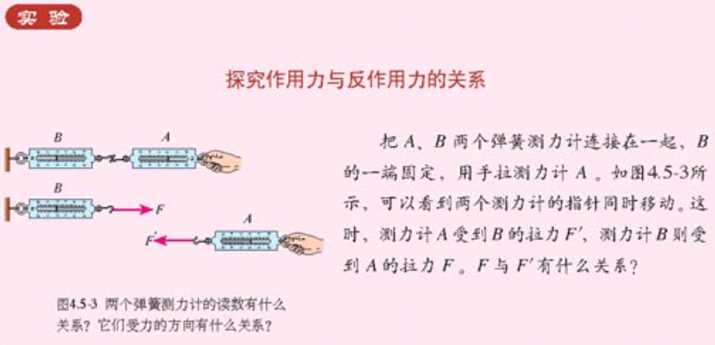
Newton third law
Notes:
探究作用力反作用力的关系，两个弹簧测力计一个挂墙上一个用手拉，发现两个弹簧测力计测的数值相等

Slide 16
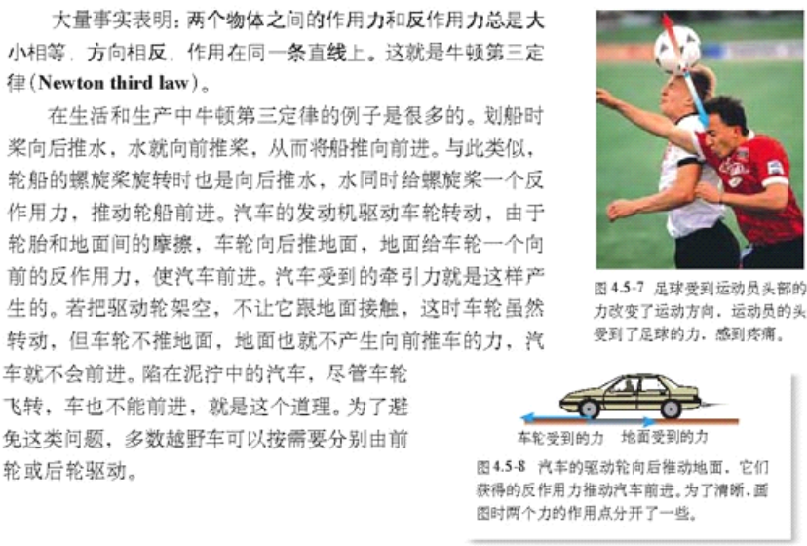
Newton third law

Slide 17
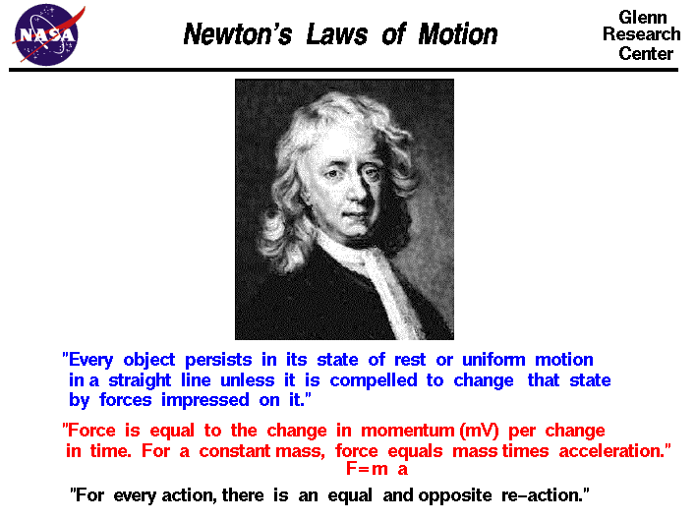
Newton’s Laws of Motion

Slide 18
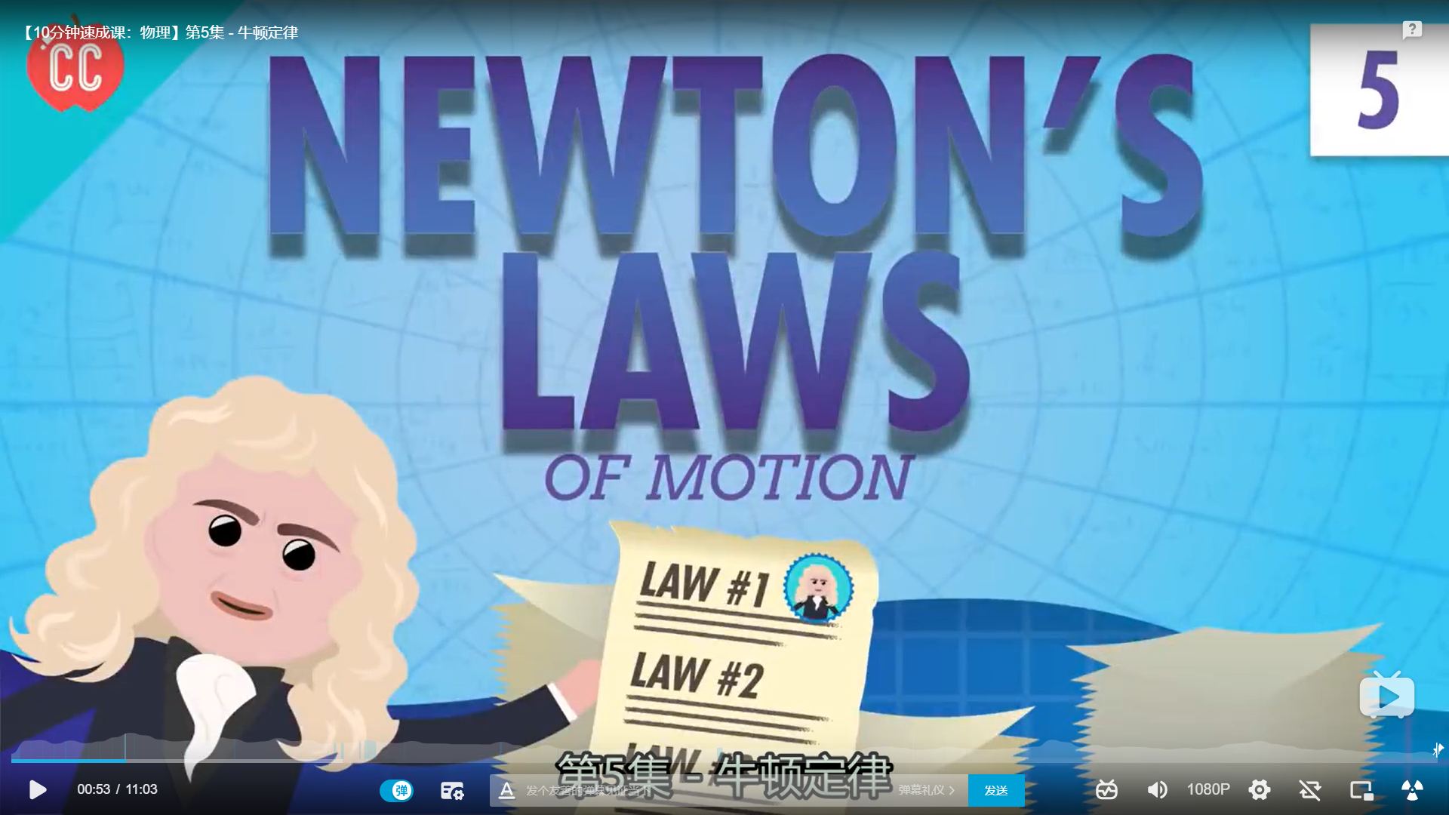
Newton’s Laws of Motion
Notes:
Crash course

Slide 19

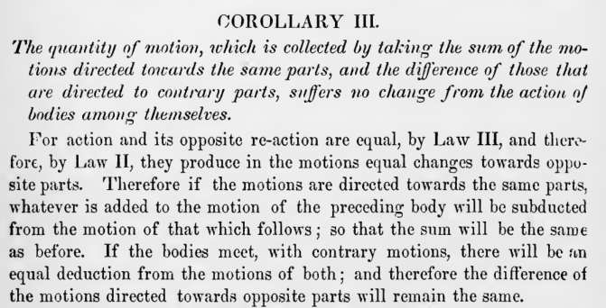
Momentum

Slide 20
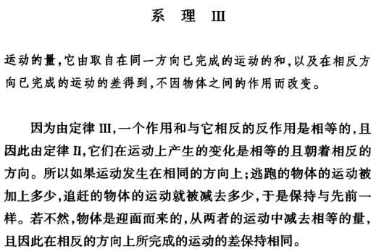
Momentum

Slide 21
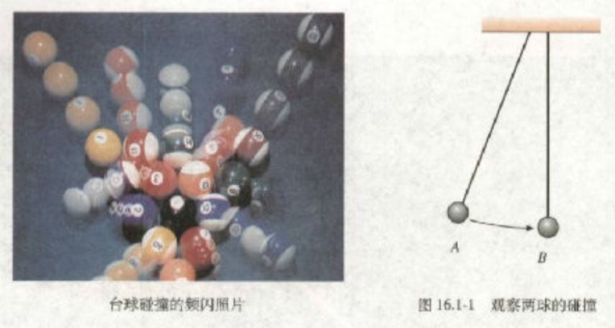
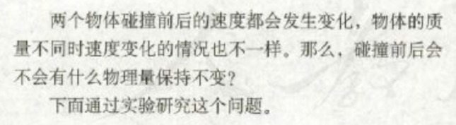
Momentum

Slide 22
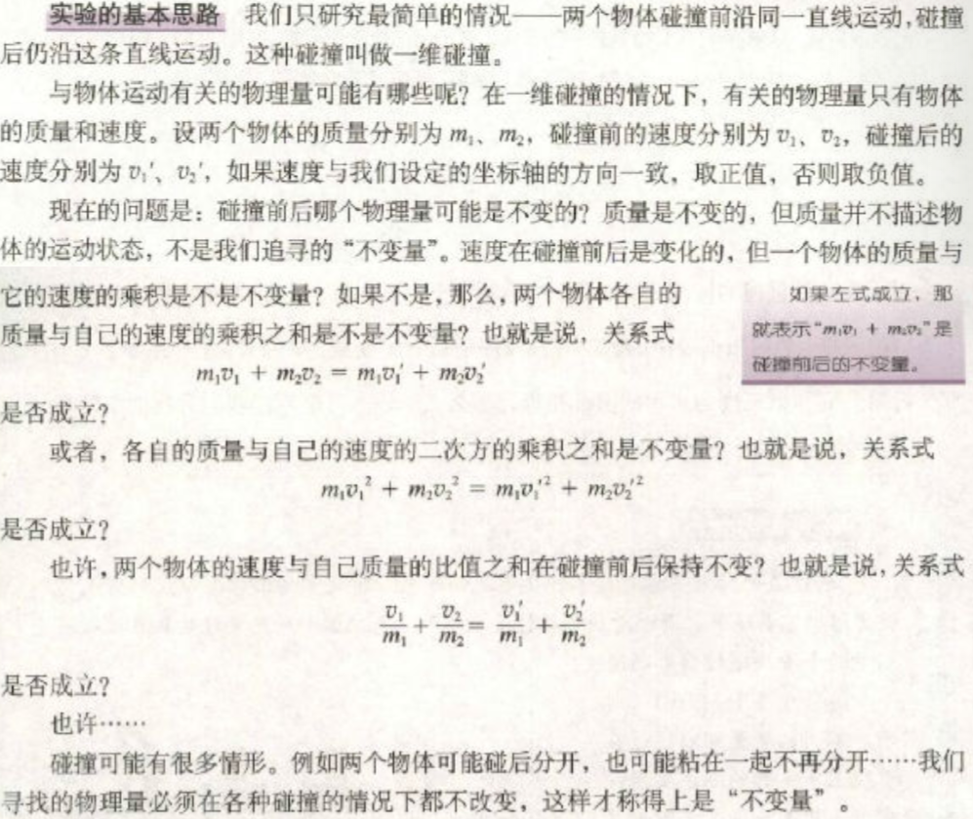
Momentum

Slide 23
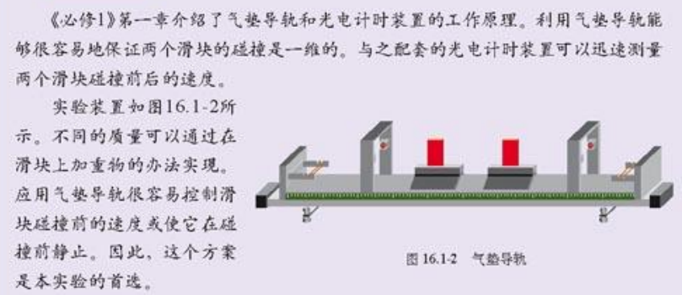
Momentum

Slide 24
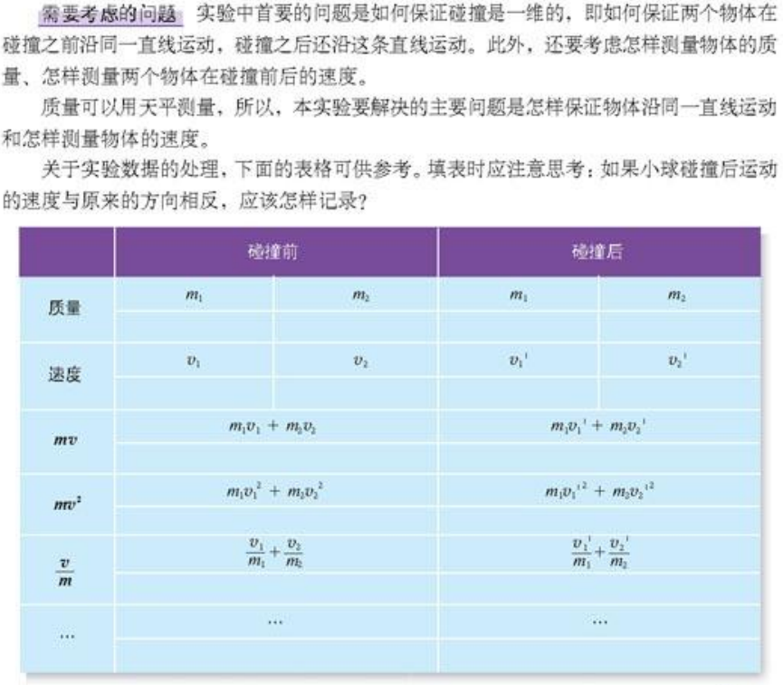
Momentum

Slide 25
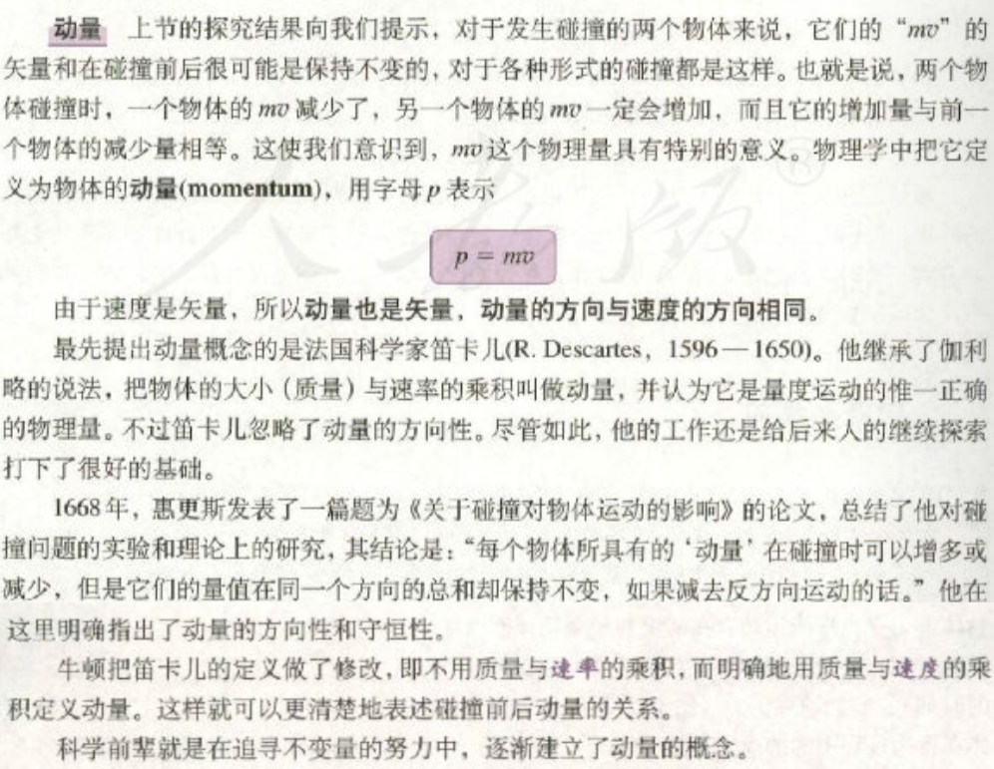
Momentum

